Slide 1
According the BB data it shares largest portion of our export.

Slide 2
The RMG sector is rising significantly ever since it started.

Slide 4
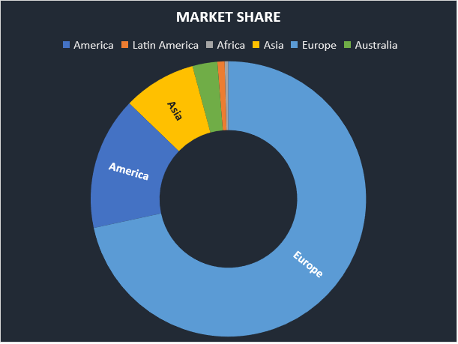
Total export market are mostly Europe.
Region Value($m) Share (%)
America 2644389094 15.59
Latin America 143232026.8 0.84
Africa 74336309.78 0.44
Asia 1454830855 8.58
Europe 12146995154 71.62
Australia 495972084.9 2.92

Slide 5
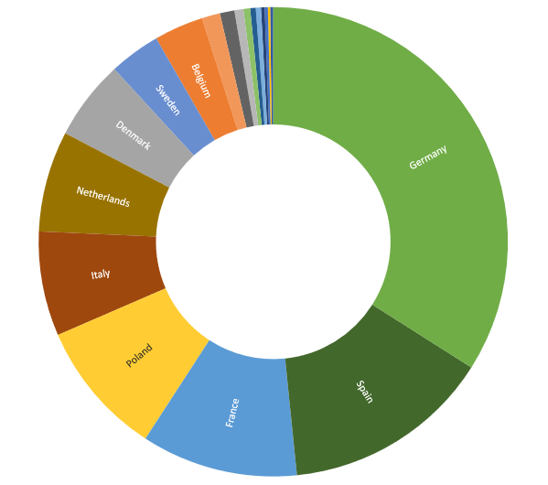
EU market
EU market 2021-22
Czech Republic 173.27
Estonia 0.72
Hungary 84.35
Latvia 0.71
Lithuania 0.21
Malta 0.1
Poland 1283.79
Slovakia 48.99
Slovenia 64.29
Croatia 10.15
Luxembourg 1.06
Austria 30.38
Belgium 467.49
Bulgaria 0.96
Denmark 757.95
Finland 21.17
France 1483.59
Germany 4677.91
Greece 34.42
Italy 991.29
Ireland 137.84
Netherlands 955.59
Portugal 52.59
Romania 14.35
Spain 1979.94
Sweden 485.75
Cyprus 0.85
Sub-Total (EU) 13759.71
EU % of World 50.04

Slide 6
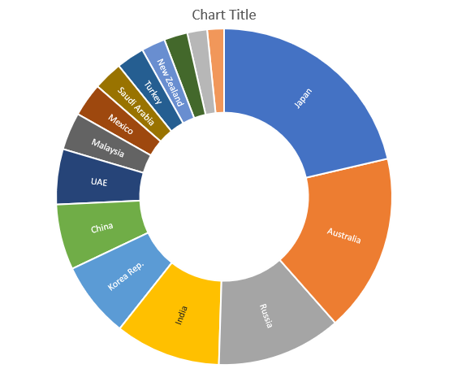
Non EU market
Japan 728.65
Australia 555.6
Russia 481.23
India 466.61
Korea Rep. 277.25
China 150.79
UAE 174.71
Mexico 169.24
Malaysia 119.25
Saudi Arabia 99.28
Turkey 87.53
South Africa 81.56
New Zealand 77.96
Chile 111.7
Brazil 65.76
Other Countries 564.04
Total (Non-Trad. Markets) 4211.17

Slide 7
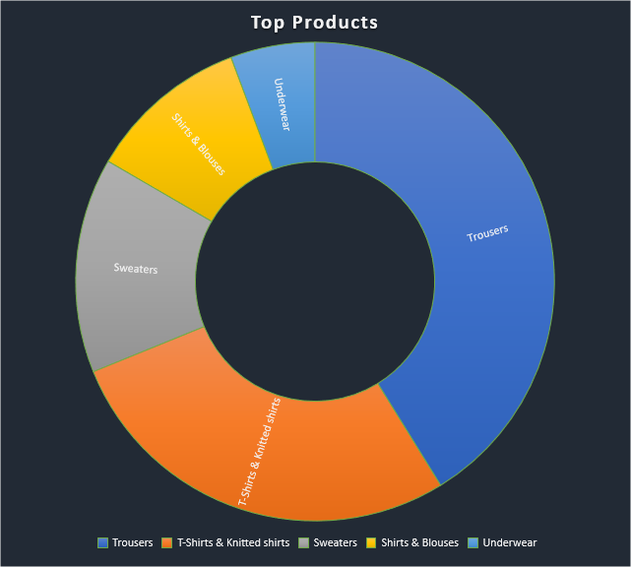
Top products
Trousers
T-Shirts & Knitted shirts
Sweaters
Shirts & Blouses
Underwear

Slide 8
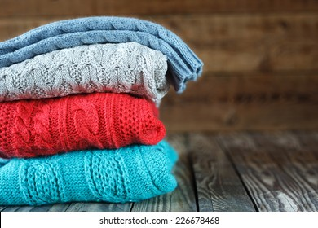
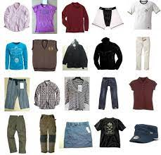
RMG market basically export two types of products.
Knitted
woven

Slide 9
Covid effects and recovery.

Slide 10
They also expoert raw materials.

Slide 11
After covid market recovery.
Country
EU_27
Germany
Great Britain
United States
Spain
France
Poland
Italy
Netherlands
Denmark
Canada
Japan
Australia
Sweden
Russia
Belgium

Slide 13
Export growth in Non EU in 2022.

Slide 15
Last year to 2021 growth in EU market.

Slide 16
It is predicted that the industry will further rise.

